Slide 1
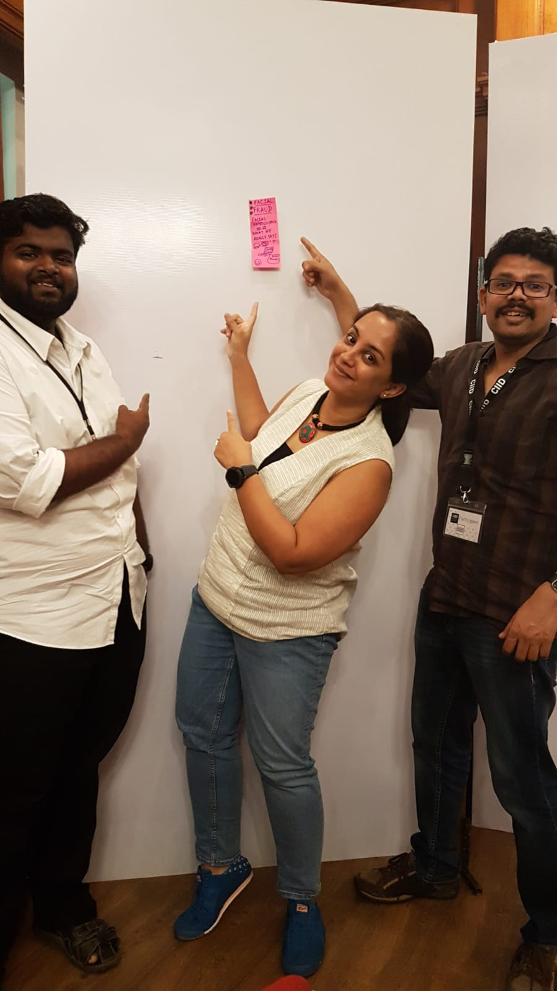
Facial Fraud Say only what you mean!
Purnima Kamath
Sudheer Mohan
Krishan Chandran KS
Marshall Keyes

